Slide 1
Living Smart @ Smart Home
¹Vishnu Sivan, ²Hema Dileep, ³Romario Johnson
P.G Scholar
Dept.Computer Applications
Mar Athanasius College of Engineering
Kothamangalam, India
⁴Shinu S Kurian
Assistant Professor
Dept.Computer Applications
Mar Athanasius College of Engineering
Kothamangalam, India

Slide 2
OUTLINE
Introduction
Objective
Literature review
Why Smart Home
Methodology and work description
Design steps
Conclusion
Reference

Slide 3
INTRODUCTON
A smart home is one in which the various electrical and electronic appliances are wired up to a central computer control system so that they can either be switched on or off at certain times.
Smart home is a well-equipped system that concentrates mainly on energy saving concept.
Incorporating emotion recognition, Internet of things (IoT) and online shopping with the system will enhance the saving perspective and also provide more satisfaction to the user.

Slide 4
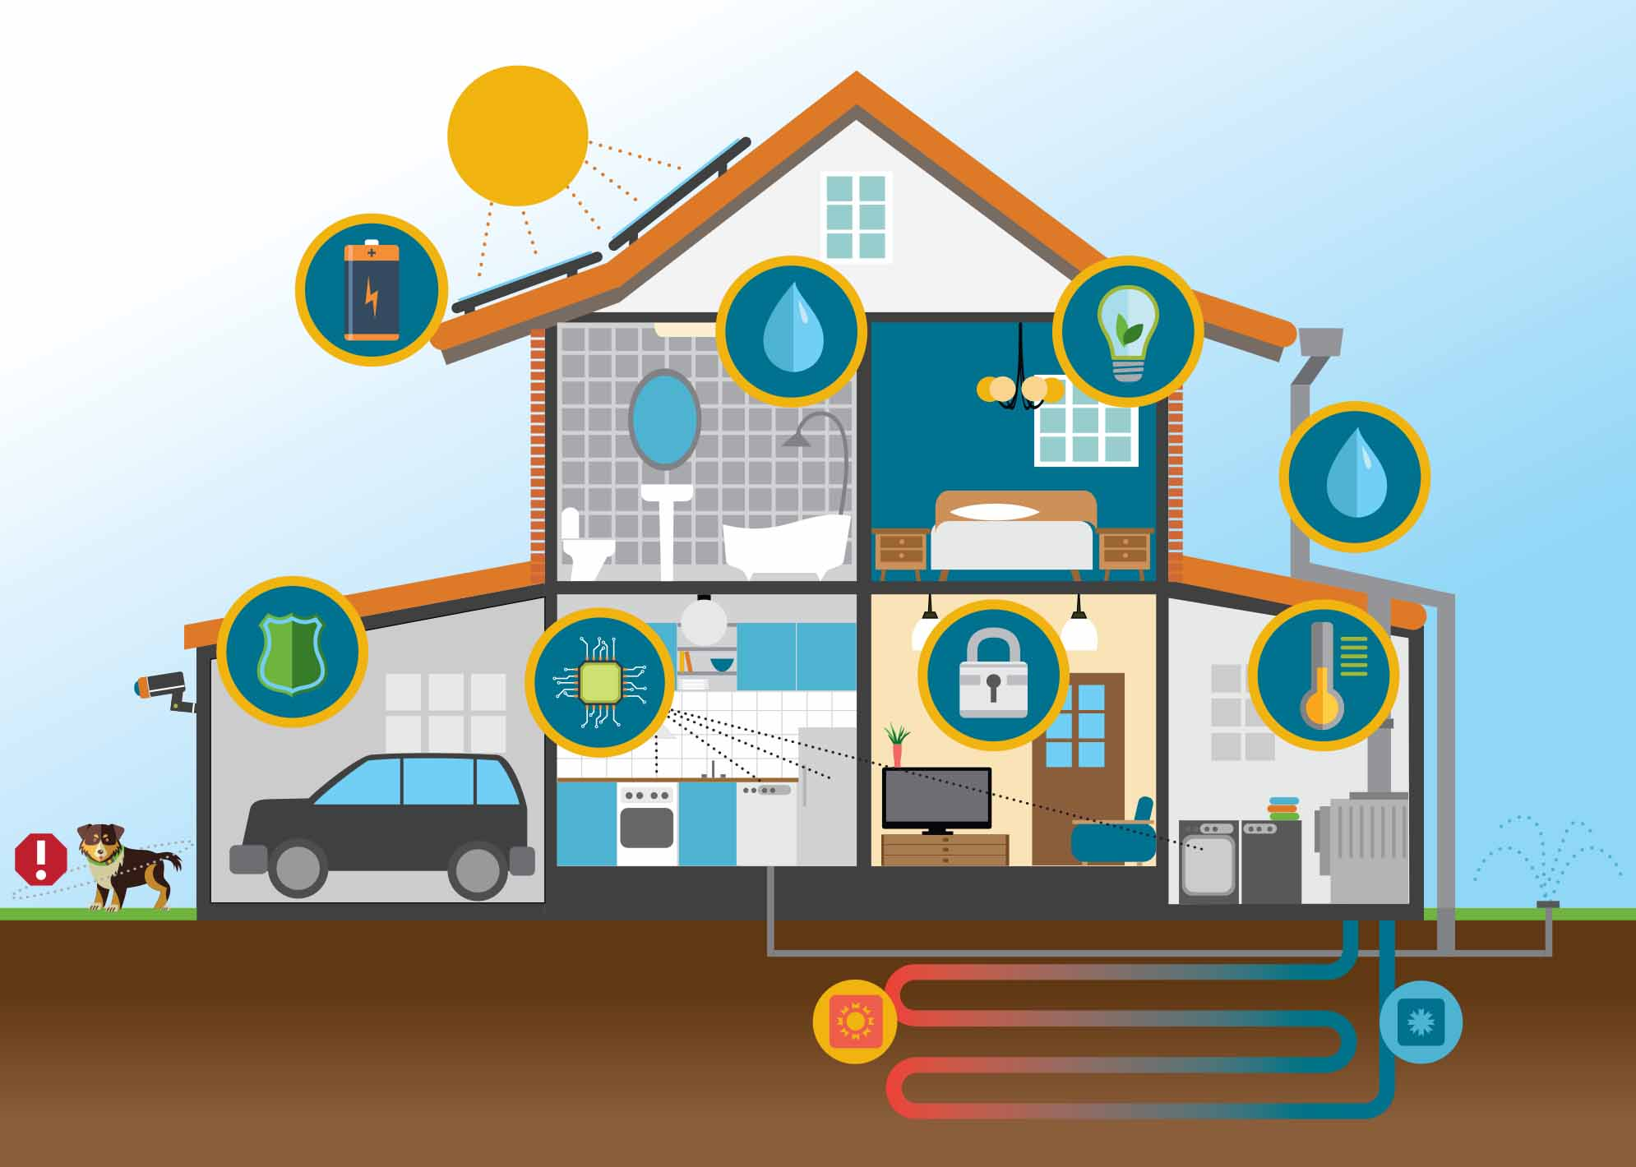

Slide 5
INTRODUCTON (Contd.,)
Make homes truly smart and green by utilizing home controllers integrated with all home sub­systems to controlling lighting, window coverings, HVAC, irrigation and by monitoring usage
Remote access to the home appliances
system takes any actions while the environmental changes are reported via the connected smart device

Slide 6
OBJECTIVES
Smart home technology intelligently gives you ultimate control over your home by automating the lighting system , dimming, blinds, electrical appliances, audio and security systems
Smart homes connect all the devices and appliances in your home so they can communicate with other and with you
Smart homes make use of Artificial Intelligence, IoT, and Embedded Systems to control, monitor and optimize household appliances and systems

Slide 7
OBJECTIVES (Contd.,)
Improve comfort/Ease of control
Simplify use of technologies
Ensure security
Enhance accessibility
Provide entertainment and convenience at all times
Provide a smart way of living

Slide 8
LITERATURE REVIEW
PAPER NAME AND AUTHOR | CONTRIBUTION | ADVANTAGES | LIMITATIONS
Next-generation insurance: tapping into the intelligence of smart homes, agil francis | Smart home architecture (Smart homes comprise three unique components: home appliances, home security devices and home infrastructure) | Remotely controlled appliances Interconnected devices | Privacy and security Interconnectivity and data standardization
Technology, systems and implementation of a smart home automation system: A review, suraj bhatia |  | Zigbee technologies Benefit for elderly or disabled persons living alone
Home automation using internet of things, vinay sagar | Cloud based system design | Integration of cloud networking Low cost design | Intellectual components are not comprised

Slide 9
LITERATURE REVIEW (Contd.,)
PAPER NAME AND AUTHOR | CONTRIBUTION | ADVANTAGES | LIMITATIONS
Design and Implementation of an IoT Access Point for Smart Home, Chih-Yung Chang | The design and implementation of an IoT access point coordinating various wireless transmission protocols( Wi-Fi, ZigBee) | The original Wi-Fi AP can be upgraded to an IoT AP | Need more user interactions Less automated architecture
Artificial intelligence techniques for advanced smart home implementation, M. B. I. REAZ | Highlights research projects employing multi-agent system, action prediction, artificial neural network | Artificial Intelligence provide more efficient system | Less intelligence are provided. There is no feedback mechanism

Slide 10
WHY SMART HOME
Lifestyle personalization
Busy life in modern era
Security
Controlled motion sensors which allows for observation of activities
Ease of Control
Automated control of electric gadgets
SMART homes offers benefits for the disabled and elderly persons in the various ways
Monitory systems
Alert systems for the notification on prescribed medications

Slide 11
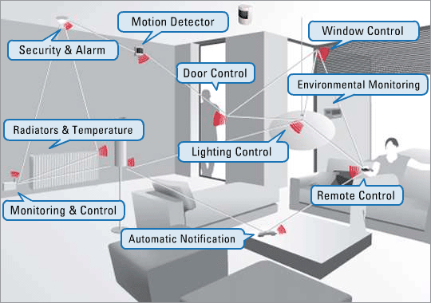
METHODOLOGY AND WORKING

Slide 12
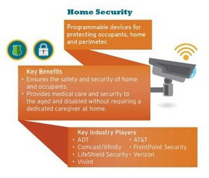
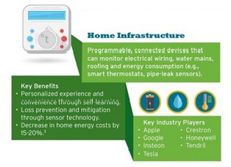
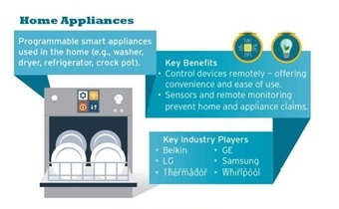
WORKING (Contd.,)

Slide 13
WORKING (Contd.,)
i. Controlled Devices:
The controlled devices (Air Conditioner, Light, Fan, Gate and Motor) are connected with a controller which is used to make the configuration of the device according to predictions and the previous stored results.
ii. Controller:
Controller is responsible to control the home appliances with improved level of access and enhanced prediction mechanism to take automatic configuration for the respective devices.
iii. I/O Interfaces:
The sensors are repeatedly tracking the user changes including their emotion as such.

Slide 14
WORKING (Contd.,)
Capture data on User Interaction
Accept by I/O interfaces
(Sensors)
Pass information to the controller,
if it necessary
Controller extract user changes,
Make necessary configuration as stated in prediction
User acceptance review and
Environmental changes
Accumulate the updated configuration, user behavior and situation

Slide 15
WORKING (Contd.,)
Capturing the user’s emotions by the I/O interface and passes to the controller
Data acceptance
Valid data is taken for analysis and predict the action to be taken
Invalid data is ignored
Controller refreshes its state and the I/O interface continues its capturing

Slide 16
SMART HOMES - FEATURES
Effectual Power Utilization
Eco friendly energy generation
Intellectual electrical appliances
Advanced home architecture
Home Security System
Security cameras
Controlled access
Emergency
Ease of Access
Efficient appliances with more output and less input

Slide 17
FEATURES(Contd.,)
Waste Management
Well-organized Biogas plants
Electrified decomposition of Non Biodegradable wastes
Fault Detection
auto correct option
Controlled Exterior and Interior Lighting
Efficient power utilization

Slide 18
CONCLUSION
Proposed system is more concentrate on user’s behavior
It has a prediction mechanism based on the user’s behavior and take necessary configuration to maintain the user’s happiness
More secure , responding upon the user changes only the presence of authenticated person
Easier to access, the I/O interfaces continuously track the user’s changes and pass it to the controller for made appropriate changes
Reduce the power usage

Slide 19
REFERENCES
Agil Francis is a Principal/Director with Cognizant Business Consulting’s Insurance Practice, “Next-Generation Insurance: Tapping into the Intelligence of Smart Homes”
Vinay sagar K N1, Kusuma S M2, Student IV SEM, M.Tech, Digital Communication. Engg., MSRIT, Bangalore, India , “Home Automation Using Internet of Things”
Suraj Bhatia, Students, Department of Electronics and Telecommunication, Thadomal Shahani Engineering College, Bandra, Mumbai, “Technology, Systems and Implementation of a Smart Home Automation System: A Review”
Chih-Yung Chang, Department of Computer Science and Information Engineering, Tamkang University, No. 151, Yingzhuan Road, Tamsui District, New Taipei City 25137, Taiwan; “Design and Implementation of an IoT Access Point for Smart Home”
M. B. I. REAZ, department of electrical, electronic and systems engineering, universiti kebangsaan malaysia 43600, ukm, bangi, selangor, Malaysia, “Artificial intelligence techniques for advanced smart home implementation ”

Slide 20
REFERENCES (Cont.)
Dhiren Tejani, Ali Mohammed A. H. Al-Kuwari, Energy Conservation in Smart Home, 5th IEEE InternationalConference on Digital Ecosystems and Technologies,Daejeon, Korea, May 2011
Jaszczyk P, Król D (2010). Updatable multiagent OSGi architecture for smart home system. Agent and Multi-Agent Systems: Technologies and Applications. 6071: 370-379.
U.A. Bakshi, V.U. Bakshi, “Principles of Control Systems”, chapter 1, page 1-2, Technical Publications.
Press Release: “Smart Home Revenues to reach $71 billion by 2018, Juniper Research Finds,” Juniper Research, February, 2014
“SAMSUNG to Acquire SmartThings, Leading Open Platform for the Internet of Things,” samsung.com, August, 2014.
http://www. samsung.com/us/news/23607

Slide 21
Thank You

